Slide 1
FOR INTERNAL USE ONLY
Invision Spike in Agile Apps and Analytics MI
Possible Operating Models
Sudeep Pournami, Mandy Cadman, Timea Kosa, Piotr Piech
Information classiﬁcation: Internal

Slide 2
Agile Apps F&SA
Is a bespoke
App development environment
where internal web applications are
Designed, Built and Hosted
to solve
Operational problems
for Bank internal customers

Slide 3
Analytics MI
Are Data visualisations served as Tableau dashboards to help bring data to life using analytical insights

Slide 4
Pain-point
Capturing stakeholder requirements and feedback from the outset efficiently reducing rework where possible

Slide 5

What is Invision
FOR INTERNAL USE ONLY
Allows design teams to create interactive prototypes of web and mobile applications and gather instant feedback from key stakeholders through social and collaborative capabilities.
Large interest in multiple areas in Natwest group as the go to tool for UI design collaboration.
Information classiﬁcation: Internal

Slide 6



Invision spike setup
11th Aug 2020 – 14th Aug 2020
Developers, Designer from Agile Apps
Data Engineers from Data Engineering
SME support from Invision
Proving statement:
Prove viability and lay down operating model for Use of Invision in Agile Apps and Analytics MI reporting

Slide 7
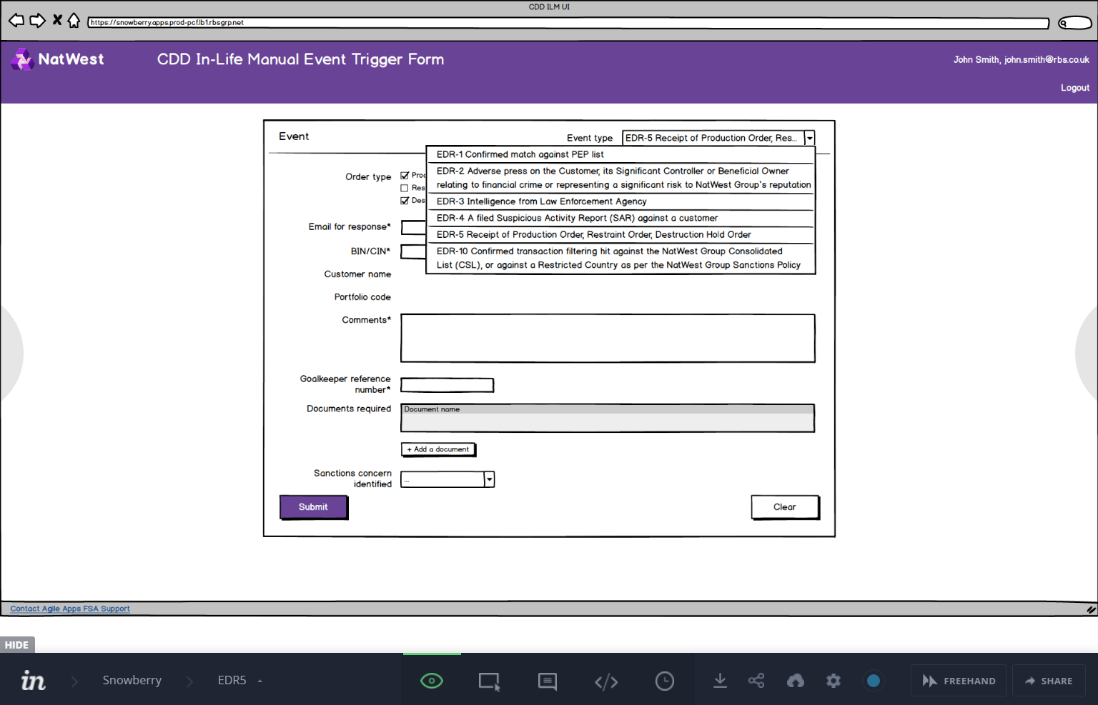
What we did in spike — Agile Apps
Static Balsamiq wireframe mock-ups
Mock-ups made interactive in InVision prototype
Collaboration with stakeholders with the prototype as the basis.
Addressing feedback by updating the prototype to match refined requirements.

Slide 8
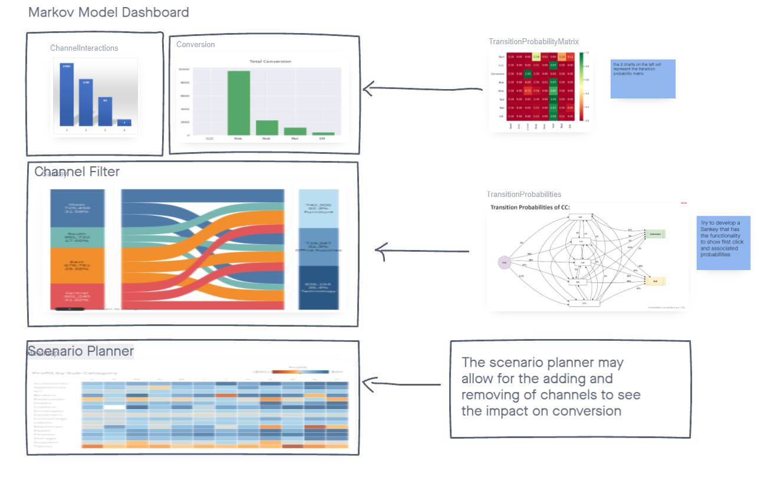
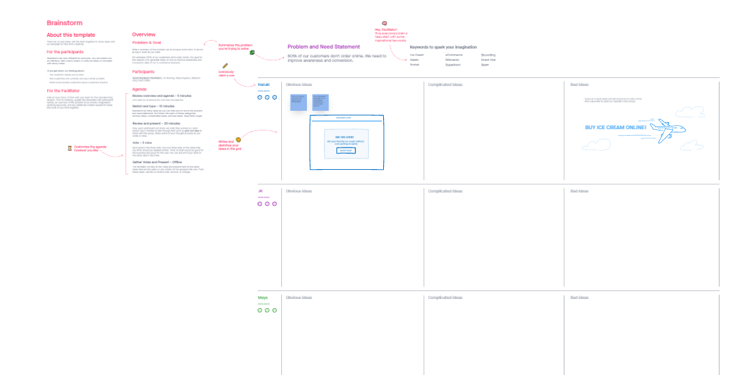






What we did in spike – Analytics MI
Investigated the capabilities of the tool:
Prototype
Boards
Freehand
Developed a prototype dashboard
Created Collaboration templates
Used boards to display visualisations
Collaborated with Colleagues on design

Slide 9
Proposed Agile Apps design operating model
Confluence, JIRA
Balsamiq Mockups
Static wireframe mock-up screens
InVision prototype
Interactive wireframe prototype
Initial requirements gathering
Stakeholder feedback
Comments
Updating Balsamiq wireframe mock-ups
Addressing feedback
Freehand
Marking comments as resolved
Updating the live prototype

Slide 10
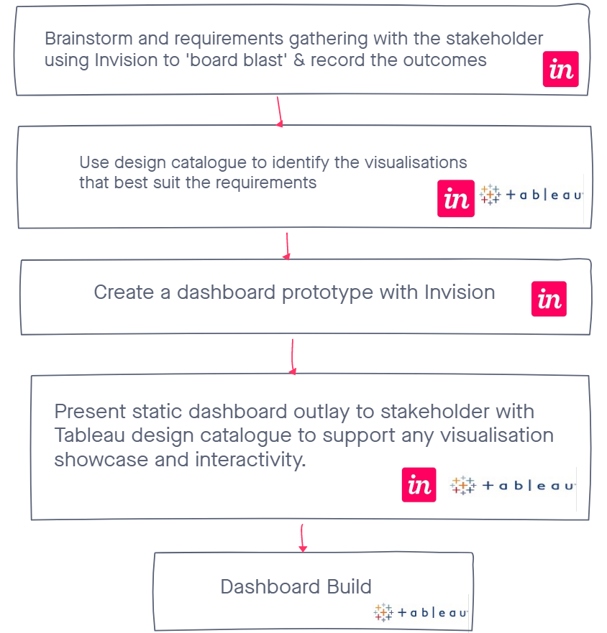
Proposed Analytics MI design Operating model
Model built using Invision

Slide 11
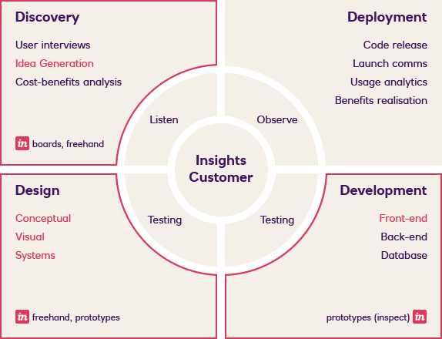
Performance Insights Operating model

Slide 12


Spike results
Invision is a good collaboration tool when creating visualisations and allows multiple users to edit at the same time.
Invision would allow for an interactive session with stakeholders to gather requirements.
Invision does not allow for demonstrating the interactivity and power of Tableau.
Invision has to be used on Microsoft Edge (for creators and viewers)
Licences are not required to allow for collaboration with stakeholders.
Spin off use in general Idea co-authoring and collaboration, Eg: Team building activity templates
Invision Studio installation issues identified and being worked through with VCSe teams

Slide 13
The A Team
Piotr Piech
Mandy Cadman
Saransh Bansal
Timea Kosa
Basil Marinelis
Anushile Agarwal
Sudeep Pournami
Jonathan Carroll

Slide 14
FOR INTERNAL USE ONLY
Thank you
Information classiﬁcation: Internal

